Slide 1


Day Extra Class 1
Python and
SQL Advance

Slide 2


Kurnia Anwar Ra’if
A Highly-motivated Data Scientist
Data Scientist @ PT. KitaLulus International
Data Scientist @ PT. Sharing Vision– BRI Consultant
Software Engineering @ PT. AILIMA Geothermal

Slide 3
Outline
1
Refreshment Solving Code in Python and SQL
2
Hands-On Python
3
Hands-On SQL
4

Slide 4
Refreshment Solving Code in Python and SQL

Slide 5
Refreshment Solving Code in Python and SQL
1. Pahami Soal dengan Baik:
2. Buat Rencana Solusi
Baca soal secara menyeluruh dan pahami apa yang diminta. Serta pahami outputnya (Cari kata kunci)
Pecahkan masalah menjadi langkah-langkah kecil yang bisa dikelola. Buat pseudo-code atau flowchart
3. Mulai dengan Solusi Sederhana
4. Gunakan Fungsi dan Modul:
Implementasikan solusi langkah demi langkah dan lakukan pengujian pada setiap langkah
Fungsi / function untuk membagi kode menjadi bagian-bagian yang lebih kecil. modul standar Python (Numpy, SciPy, Pandas, dll)
5. Gunakan komentar pada code
Tambahkan komentar di kode Anda untuk menjelaskan logika, terutama di bagian yang rumit. Ini dapat membantu di kemudian hari.

Slide 6
Refreshment Solving Code in Python and SQL

Slide 7
Refresh in Python
Data Structures Mapping in Python

Slide 8
Data Structures Mapping
Primitive
Non-Primitive
Integer
List
Float
Array
Matrix
Boolean
Tuple
String
Set
Dictionary

Slide 9

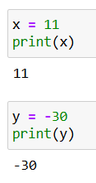
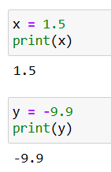
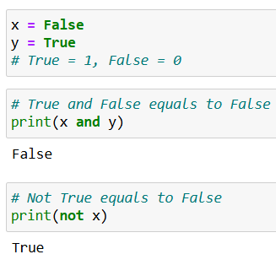

Data Type and Structure : Primitive
Integer is a whole number, ranges from negative infinity to positive infinity
Float is the decimal number or floating points number, ranges from negative infinity to positive infinity
Boolean (logical) is the built-in data type than is either `True` or `False`
String is a collection of characters. You can write string using `'` or `"`.
Based on kind of primitive in data type and structure above, we can do basic calculation in python.
Integer
Float = Decimal
Boolean (logical)
String

Slide 10
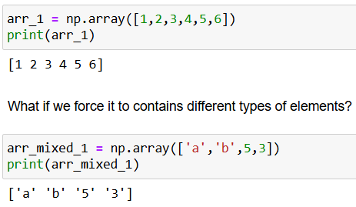
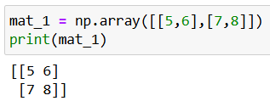
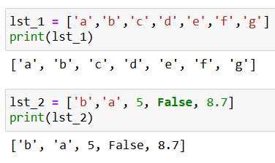
Data Type and Structure : Non-Primitive
- List / Vector is a data structure in python that can saves many different types of other items.
- Array is a data structure used to store a collection of values or elements, typically of the same data type
- Matrix is basically just an array of arrays. This is a 2 dimensional arrays.
Based on kind of non-primitive in data type and structure above, we can do basic calculation in python.
Array
Matrix
List

Slide 11
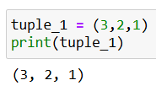
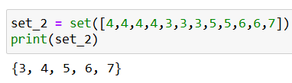
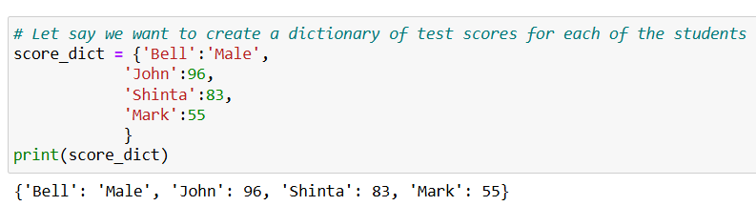
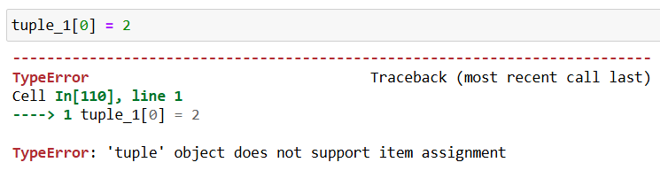
Data Type and Structure : Non-Primitive
- Tuple is another data structures that is similar with list. Once it is defined, you can not delete, add or edit any values inside it. Ex : Constant scientific value such as value of gravity.
- Set is another list-alike data structure. However, set contains only unique values and it is not ordered.
- Dictionary is a data structure that enables us to have a direct access for specific value via the corresponding key.
Based on kind of non-primitive in data type and structure above, we can do basic calculation in python.
Tuple
Set
Dictionary

Slide 12
When to Use Each Non-Primitive Data Structures?
Data structure | Suits best when...
List | wanted to store >=1 value types either is is hashable or not the order is important the value is possible to be changed (replaced, added, removed) in the future
Array | (same with list) wanted to apply operation on all its item individually
Matrix | the information wanted to be stored is > 1 dimensions
Tuple | wanted to save a constant set of values (can’t be changed in the future)
Set | wanted to save unique set of values wanted to save hashable items (float, integer, boolean, string, tuple) only no order information
Dictionary | wanted to save an unordered set of unique keys that map to values no order information
*hashable means that the value does not change during its lifetime
Notes:
Jadi terdapat banyak pilihan data structures yg ada di Python
Dari sesi demo sebelumnya, kita sudah sama2 melihat bagaimana cara menggunakannya
Namun, pertanyaan lebih pentingnya adalah kapan kita harus menggunakan masing2 data structures tsb?
Karena hanya mengetahui bagaimana cara menggunakan tentunya tidak cukup jika tidak tahu kapan hrus menggunakannya.

Slide 13
Refresh in Python
Hands-On Python

Slide 14
Refreshment Solving Code in Python and SQL

Slide 15
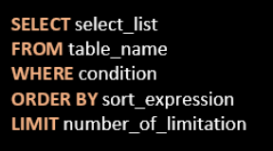
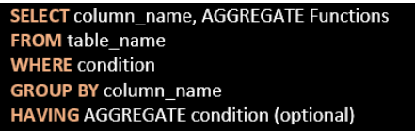
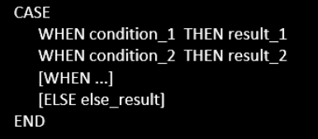
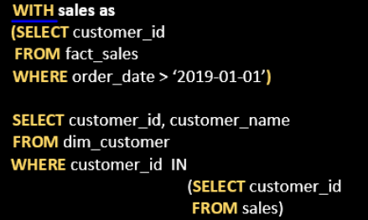
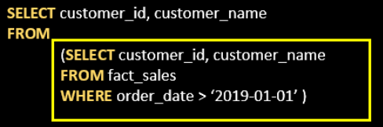
Refresh in SQL
Basic SQL Query
Aggregate Statement
Case When Condition
Sub Query : CTE
Sub Query : Nested / From Function

Slide 16
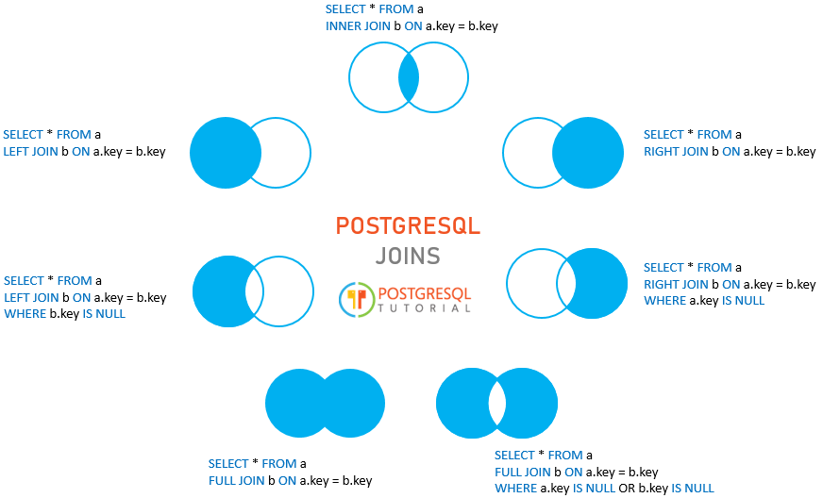
Refresh in SQL
Various Join Table in SQL

Slide 17
Refresh in SQL
Hands-On SQL

Slide 18
Referensi : 1. Data Structure : https://docs.python.org/3/tutorial/datastructures.html 2. SQL Syntax : https://www.w3schools.com/sql/sql_syntax.asp 3. SQL : PandaSQL Library https://www.datacamp.com/tutorial/how-to-use-sql-in-pandas-using-pandasql-queries and https://www.kdnuggets.com/sql-in-pandas-with-pandasql and https://medium.com/@davidfagb/using-sql-with-pandas-dataframes-1c36f57ea65d

Slide 19


Thank you
https://www.linkedin.com/in/anwaraif/
kurniafreelancer@gmail.com

